Slide 1
PHP in depth 4
3870

Slide 2
Review
What does the following regular expression match?
/^[a-zA-Z_\-]+@(([a-zA-Z_\-])+\.)+[a-zA-Z]{2,4}$/

Slide 3
PHP Form validation
// regexes can be used to validate
// parameters
$state = $_REQUEST[“state”];
if(!preg_match(“/^[A-Z]{2}$/”, $state)) {
print “Error, invalid state submitted.”;
}

Slide 4
Exercise
What regular expression matches letter grades such as A, B+, B-, C, D+?
What regular expression matches dollar amounts of at least $100.00?

Slide 5
Review cont.
What is the PHP function that prevents an SQL injection attack like the following:
Original query:
$query = “SELECT * FROM students WHERE username = ‘$username’ AND password = ‘$password’;
PASSWORD: ‘ OR ‘1’=‘1
Executed as:
$query = “SELECT * FROM students WHERE username=‘$username’ AND password=‘’ OR ‘1’=‘1’”;

Slide 6
Cookies
cookie: a small amount of information sent by a server to the browser, and then sent back by the browser on future page requests
cookies are used for authentication, user tracking, user preferences, shopping carts, etc
cookies data consists of single name/value pair
(sent in header of the client's HTTP GET or POST request)

Slide 7
Cookies
session cookie: default type, temporary cookie that is stored only in the browser's memory
persistent cookie: stored in a file on the browser's computer

Slide 8
Session Cookies in PHP
setCookie("name","value");
setCookie("itec3870","soft dev 2");
setCookie("lang","php");
setCookie causes your script to send a cookie to the user's browser
setCookie must be called before any output statements
can set multiple cookies (20-5) per user, each up to 3-4K bytes

Slide 9
Retrieving from a cookie
$variable = $_COOKIE["name"];
if (isset($_COOKIE["username"])) {
$username = $_COOKIE["username"];
print("Welcome back, $username.\n"); } else {
print("Never heard of you.\n");
}
print("All cookies received:\n");
print_r($_COOKIE);

Slide 10
Persistent cookie in PHP
setCookie("name","value",timeout);
$expireTime = time() + 60*60*24*7; // 1 week
setCookie("CouponNumber","1122", $expireTime);
setCookie("CouponValue","100.00", $expireTime);
set a persistent cookie by passing a third parameter for its timeout in seconds

Slide 11
Removing a persistent cookie
setCookie("name", "", time() – 1);
setCookie("CouponNumber", "", time() -1);
remove a persistent cookie by setting it again with a timeout that is prior to the present time

Slide 12
Exercise
Show how many times a user visited a page using a cookie.

Slide 13
Session 1
An abstract concept to represent a series of HTTP requests and responses between a specific Web browser and server
(HTTP doesn't support it but PHP does)
Sessions vs cookies
a cookie is data stored on the client
a session's data is stored on the server (only 1 session per client)

Slide 14
Session 2
sessions are often built on top of cookies:
the only data the client stores is a cookie holding a unique session ID
on each page request, the client sends its session ID cookie, and the server uses this to find and retrieve the client's session data

Slide 15
Session 3
Client’s browser makes an initial request to the server
Server notes client’s IP address/browser, stores some local session data, and sends a session ID back to client
Client sends that same session ID back to server on future requests
Server uses session ID to retrieve that data for the client’s session later, like a ticket given at a coat-check room

Slide 16
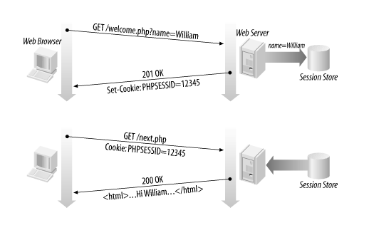

Slide 17
Session Example
session_start();
session_start signifies your script wants a session with the user (must be called at the top of your script, before any HTML output is produced)
When session_start() is called
If the server hasn’t seen this user before, a new session is created
Otherwise, existing session data is loaded into $_SESSION associative array
You can store data in $_SESSION and retrieve it on future pages

Slide 18
Accessing session data
$_SESSION[“name”] = value;
$variable = $_SESSION[“name”];
if(isset($_SESSION[“points”])) {
$points = $_SESSION[“points”];
print(“You’ve earned $points points.\n”);
} else {
$_SESSION[“points”] = 0;
}
// $_SESSION associative array reads/stores all session data

Slide 19
Where is session data stored?
On the client, the session ID is stored as a cookie with the name PHPSESSID
On the server, session data are stored as temporary files such as /tmp/sess_fcc13f091
Server automatically cleans up old sessions after a period of time
Old session data consumes resources and may present a security risk
Adjust PHP server settings or with session_cache_expire()

Slide 20
Ending a session
session_destroy();
session_destroy() ends your current session
Potential problem: if you call session_start() again later, it sometimes reuses the same session ID/data you used before
To start a completely new session, best to flush out the old one:
session_destroy();
session_regenerate_id(TRUE);
Session_start();

Slide 21
Exercise
Create a page called the “simpsons.php” that chooses a random Simpsons character for the user.
The page should remember the character for the user and show it again each time they visit the page.
If the user selects “start over”, the character should be forgotten.

Slide 22
To be continued…

